Slide 1
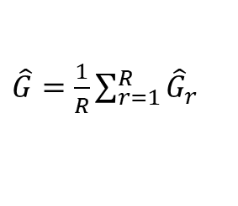

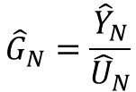




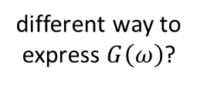
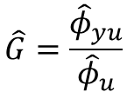
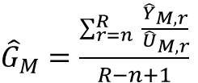


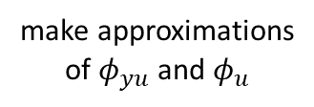
Methods to estimate a transfer
function in open-loop
convolution in freq. domain
<==>
multiplication in time domain
(autocorrelation)
==> time domain windows
make DFT length large:
frequency domain
densely covered
==> convolute with
smoothing filter
DRAFT
smooth the DFTs
make approximations
of $φ_{yu}$ and $φ_{u}$
convolution in freq.
domain is computationally
costly
sparse spectrum
different way to
express $G\left(ω\right)$?
remove n transient
periods
sophistication
make u M-periodic**
$$\hat{G}=\frac{{\hat{φ}}_{yu}}{{\hat{φ}}_{u}}$$
usefulness
get ETFE from
N-point DFTs
holy grail,
theory
noisy
can see noise spectrum
still noisy
can see noise spectrum
level of coolness
$$G=\frac{φ_{yu}}{φ_{u}}$$
high variance
ETFE erratic
${\hat{G}}_{M}=\frac{\sum_{r=n}^{R}{ \frac{{\hat{Y}}_{M,r}}{{\hat{U}}_{M,r}}}}{R−n+1}$
Barlett’s procedure:
split dataset
choose weights
according to input
energy at every freq.
Todo:
- Time domain windowing
- Welch’s method
$$G=\frac{Y}{U}$$
$${\hat{G}}_{N}=\frac{{\hat{Y}}_{N}}{{\hat{U}}_{N}}$$
${\hat{G}}_{M}=\frac{1}{R}\sum_{r=1}^{R}{\frac{{\hat{Y}}_{M,r}}{{\hat{U}}_{M,r}}}$
variance not optimal
$${\hat{φ}}_{u}=ℱ𝒯\left\{R_{u}\right\}$$
$\hat{G}=\frac{1}{R}\sum_{r=1}^{R}{{\hat{G}}_{r}}$
$\hat{G}=\sum_{r=1}^{R}{α_{r,ω}{\hat{G}}_{r}}$
Lyung 2.83:
$$φ_{yu}=G⋅φ_{u}$$
u is under our control
==> ${\hat{φ}}_{u}$ very accurate
(u is nonperiodic)
3.8
3.25 – 3.30
3.20 – 3.25
3.33
3.32 – 3.33
4.11
4.2 – 4.7
4.14
4.15 – 4.26
5.1 – 5.28
4.8 – 4.10
**) Ch.3 uses DFTs of length $N⋅M$,
whereas Ch. 4 uses DFTs of length M, which is usually equivalent when averaged.

